Slide 1
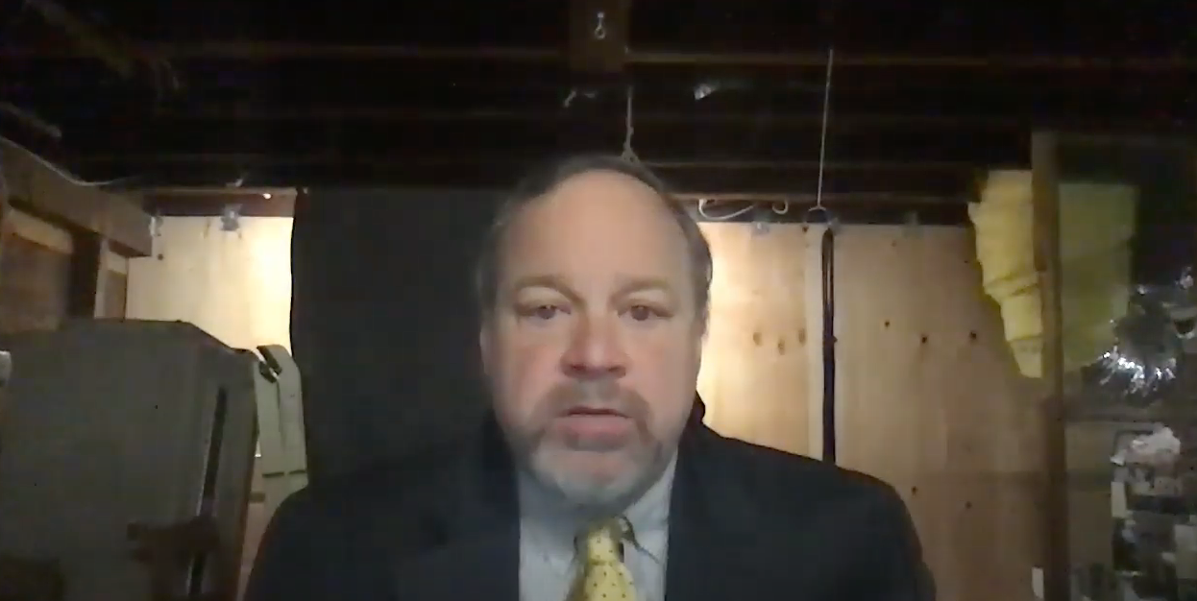
Video Introduction: 0. As Class Begins…
What we are going to be doing in this Module 0 of the course. It is a meta-module: trying to learn how we will try to learn…
Welcome!: How do we learn? Especially now, with COVID-19, when we are online? We need an answer to that question if we are not going to make a hash of this… & what is economics? What is it good for?
<https://bcourses.berkeley.edu/courses/1493152/external_tools/69468>
<https://github.com/braddelong/public-files/blob/master/econ-115-module-0.1-welcome-%23tceh-%23remote.pptx>
Notes:
Welcome to this course. I am Brad DeLong. This is my basement in the Elmwood neighborhood of Berkeley—near Ashby and college, about a mile south of the campus and about a mile north of the Rockridge BART.
Actually, that is not what it looks like now: this is a picture I took last May. What does it look like now? Behind myself as I sit at my basement desk, I have hung a green blanket. Why? To give the microprocessor in my laptop a fighting chance of distinguishing me from the background so that it can then do visual tricks to, hopefully, keep you somewhat engaged and slighty amused, and thus help you in the process of educating yourself.
What kind of tricks? Tricks like this.
This is a background against which, famously, a four-person fellowship was assigned a task in a movie.
But most of the time you will see backgrounds that are less overwhelming, while still being—we hope—visually interesting.
And most of the time you will see illustrations that will be—we hope—visually interesting and informative. This, for example, shows, week by week, from March to July 2020, how many American workers received unemployment insurance last week and had also received it the week before.
The collapse of employment and the rise of unemployment when the coronavirus plague hit was stunning: back in 2009 we had thought that the collapse of employment and the rise of unemployment in 2008-9 was stunningly big and stunningly fast. We were like John Snow in Game of Thrones: we knew nothing.
My voice, my face, my eyes, my mouth. Why have I filled your ears with the first, and put the others in front of your eyes—albeit off here in a corner? Why have I not simply assigned you some books, then said: “the exam will be in early December”, and left you to do your thing? Why are we making you glue your eyes to this screen? I have done do because we are built to find human faces and human voices uniquely arresting, interesting, and attention focusing.
Books are—a lot of the time—boring. In-person faces, gestures, and voices are a lot better.
How do we know this? We know this because the university survived the coming of printing. Let us back up two thousand years. Back then, when universities got their start, books were really, really expensive. The most comprehensive record of prices—or, rather, of what it was thought prices ought to be—in the distant past comes from an edict issued in the year 301 by the man who stabilized the resounded Roman Empire and gave it more centuries of life: the Emperor Diocletian. In his price edict he limited how much a scribe could charge for producing a copy of a book to 25 denarii to write 100 lines. What is the context? The context is that a 2.2-lb. loaf of bread costs 13 denarii, and to hire an unskilled worker for the day costs 36 denarii. A cheap book—the kind of thing you could get for, say, $10 today—thus cost the same as 440 pounds of bread, or 70 days’ work at minimum wage. Compare to today, when a cheap book costs the same as 5 pounds of bread, or 40 minutes’ work at minimum wage.
With books so expensive, how then did you get educated—unless you were already very rich to start with? The answer was that you had to travel to where the books were. With a cheap book costing the same proportion of the daily wage then as 70 days x 10 hours/day x 15/hour = 10,500 dollars is a proportion of the daily wage today, and with expensive high-quality durable books costing much more, how many books you needed to read, how many copies of, say, Aristotle’s _Nicomachean Ethics_ do you thin there were in Western Scotland in 1460? You traveled to the University of Glasgow. And there you—and all the others who wanted to learn about Aristotle’s _Nicomachean Ethics_, listened to somebody read the book aloud: “legit” it in a “lecture”, while you took your notes on it. Because afterwards your memory and your notes would be the only contact you had with Aristotle’s ideas: you certainly could not afford to spend the equivalent of $10,500 a book for anything other than your most favorite books.
That was the origin of the university: get people together to hear books read aloud. That was how universities got their start, back when books were really expensive. They were the only places you could read a few unpopoular books (in the library) and listen to the popular books books being read aloud (in the lectures). But then came Johann Gutenberg, and the printing press, and movable type, and books became really cheap. You could have your library, and read your books, almost anywhere. Yet universities did not disappear. And lectures did not disappear. They lost their principal purpose—of economizing on the number of copies of a book a univeristy needed to function—but they became: ways of getting people to go over again, in their minds, what they had read—structured repetition as a learning aid—of getting people to think actively about the ideas and connect them to things in their own mind, of getting people to engage in dialogues about the ideas, and in mobilizing human group solidarity for the educational process.
But we can no longer gather in lectures—or, rather, we do not want to run the risks involved in bringing all 100,000 or so people back to the Berkeley campus in the fall and have us act as we normally do, because we think that if we do so 60,000 of us will get sick and 500 of us—largely elderly professors and staff—die. So we are doing this instead. The problem is that making this work is very hard. We saw how hard a decade ago, with the big MOOC movement of a decade ago. Massive Open Online Courses were supposed to replace at least the in-person lecture course, and there were some who thought or hoped they would replace or at least totally transform the—expensive—university. They didn’t. Why not? It turned out to be very important to: (1) get people to do things in groups, (2) get people in the classroom in contact with each other outside the classroom, and (3) arrest and focus attention with live human voices and faces. And—as you know if you have thought about the difference between in-person plays and on-screen movies—there are lots of subtle and important ways in which our screen technologies just do not cut it.
Now, it can be done. The theme of which my first cousin Phil Lord down in Ell-Ay was one of the heads did it. But they spent $500,000 per minute creating _Spiderman: Into the Spiderverse_. Do that, and you can create something that is fully immersive and more effective than anything we see in person. Of course, you need more than money: you need genius too, and a lot of luck.
How much luck? Consider _Solo: A Star Wars Story_. The team composed of Phil and company were bounced out of the project in the middle due to “creative differences”. As I understand it, they had proposed to make a Star Wars movie that was a lot more like _Guardians of the Galaxy_ had been. They were given the greenlight. But in the middle of the project the Disney executives decided that the movie that they did not want to eat what they had ordered. So I will never see Phil, Chris, and the team’s view of the Han Solo origin story. Instead, we have a movie that lost Disney $80 million, and that brought a screaming halt to a number of projects—in fact, to all of what was supposed to be a series of future Star Wars origin spinoffs. Making convincing and arresting video is very hard.
We thus have an uphill climb. We don’t have $500K/minute to spend. And we here are not creative geniuses like my first cousin Phil and his team are. American universities are frantically piling online so that we can keep teaching. And as we do so we face an intellectual crisis about how to do our job through a screen—which is a very difficult task. Unless and until we successfully figure out how to do our job through a screen, we are going to make a total hash of moving online. Hence this first, preliminary, module of this course: a meta-module; a “how are we going to try to learn this semester” module. And also in this module I also ask and suggest some possible answers to the questions: what is economics? And: what is economics good for? Once again: welcome. I very much hope you learn stuff here, wherever “here” is, virtually. And I very much hope you have some fun here this semester.

Slide 2

My Green Blanket
Notes:
Welcome to the course. I am Brad DeLong. This is my basement in the Elmwood neighborhood of Berkeley—near Ashby and college, about a mile south of the campus and about a mile north of the Rockridge BART.
Actually, that is not what it looks like now: this is a picture I took last May. What does it look like now? Behind myself as I sit at my basement desk, I have hung a green blanket. Why? To give the microprocessor in my laptop a fighting chance of distinguishing me from the background so that it can then do visual tricks to, hopefully, keep you somewhat engaged and slighty amused, and thus help you in the process of educating yourself.

Slide 3
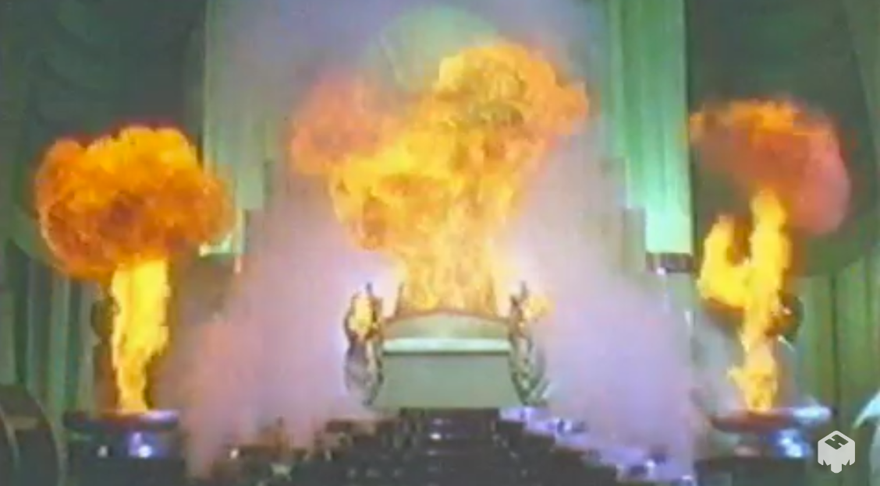
Throne Room, Palace of the Wizard, Oz
Notes:
What kind of tricks?

Slide 4
Your Task
Accomplishing it should be straightforward…
The Wizard, The Palace, Emerald City
Notes:
Tricks like this.

Slide 5
BRING ME THE BROOMSTICK OF THE WICKED WITCH OF THE WEST!
The Wizard, The Palace, Emerald City
Notes:
This is a background against which, famously, a four-person fellowship was assigned a task in a movie.

Slide 6

Berkeley at Dusk, Facing the Golden Gate
Notes:
But most of the time you will see backgrounds that are less overwhelming, while still being—we hope—visually interesting.

Slide 7

Continued Claims, March-July 2020
Notes:
And most of the time you will see illustrations that will be—we hope—visually interesting and informative. This, for example, shows, week by week, from March to July 2020, how many American workers received unemployment insurance last week and had also received it the week before.

Slide 8

Continued Claims, 2007-2020
Notes:
The collapse of employment and the rise of unemployment when the coronavirus plague hit was stunning: back in 2009 we had thought that the collapse of employment and the rise of unemployment in 2008-9 was stunningly big and stunningly fast. We were like John Snow in Game of Thrones: we knew nothing.

Slide 9

Brad DeLong Title Slide
Notes:
My voice, my face, my eyes, my mouth. Why have I filled your ears with the first, and put the others in front of your eyes—albeit off here in a corner? Why have I not simply assigned you some books, then said: “the exam will be in early December”, and left you to do your thing? Why are we making you glue your eyes to this screen? I have done do because we are built to find human faces and human voices uniquely arresting, interesting, and attention focusing. Books are—a lot of the time—boring. In-person faces, gestures, and voices are a lot better.

Slide 10

Why a Video?
Why not simply put a bunch of books in front of you?
And why not then say: “the exam is in early December”?
Why not? Because:
Books are—very often— boring.
Voices and faces are not—usually—boring.
People gain morale doing things in groups.
——
<https://ostrichpillow.com/>
Notes:
Books are—a lot of the time—boring. In-person faces, gestures, and voices are a lot better.

Slide 11
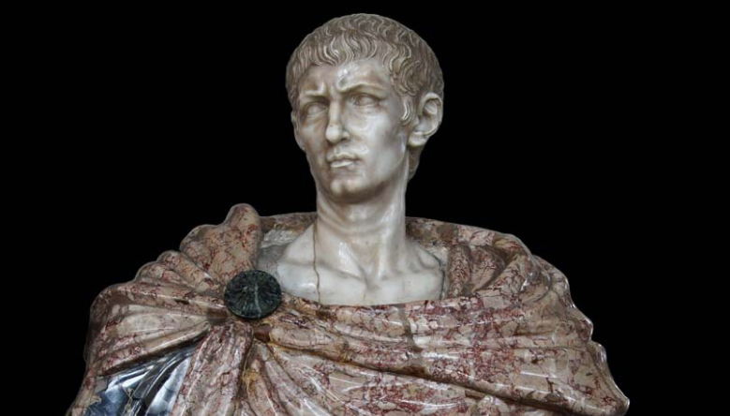
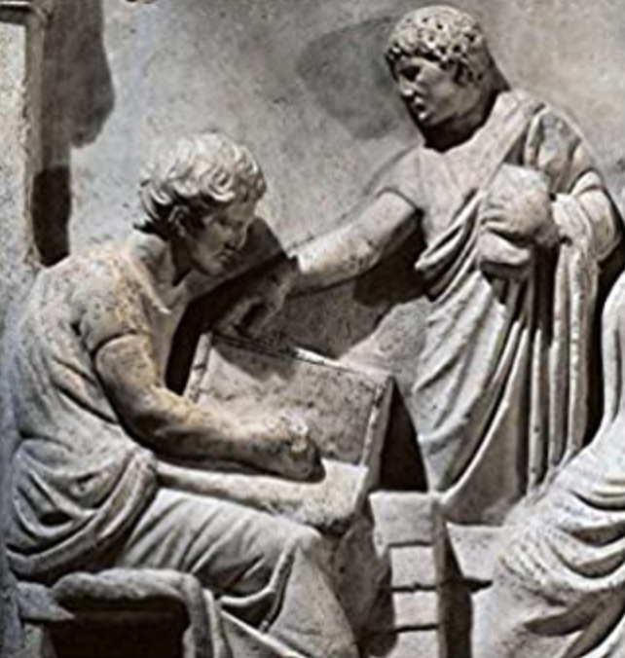
Books Used to Be Very Expensive
Go back 2000 years: Gaius Valerius Diocles:
Imperator Caesar Gaius Aurelius Valerius Diocletianus Augustus
244-311; ruled 286-305
Price Edict of 301: 25 𐆖 for 100 lines
440 lbs of bread for a cheap book; today it’s 5
$1000 for a cheap book; 10x or 20x that for high-quality one…
——
<https://github.com/braddelong/public-files/blob/master/readings/article-allen-prosperous-romans.pdf>
<https://github.com/braddelong/public-files/blob/master/readings/article-diocletian-price-edict-kropff.pdf>
Notes:
How do we know this? We know this because the university survived the coming of printing. Let us back up two thousand years. Back then, when universities got their start, books were really, really expensive. The most comprehensive record of prices—or, rather, of what it was thought prices ought to be—in the distant past comes from an edict issued in the year 301 by the man who stabilized the resounded Roman Empire and gave it more centuries of life: the Emperor Diocletian. In his price edict he limited how much a scribe could charge for producing a copy of a book to 25 denarii to write 100 lines. What is the context? The context is that a 2.2-lb. loaf of bread costs 13 denarii, and to hire an unskilled worker for the day costs 36 denarii. A cheap book—the kind of thing you could get for, say, $10 today—thus cost the same as 440 pounds of bread, or 70 days’ work at minimum wage. Compare to today, when a cheap book costs the same as 5 pounds of bread, or 40 minutes’ work at minimum wage.

Slide 12

How Do You Then Get Educated?
TRAVEL TO WHERE THE BOOKS ARE:
Just how many copies of the Nicomachean Ethics are there in Western Scotland, anyway?
Listen to the book being read aloud
And take your notes…
LECTURE:
NOUN: An educational talk to an audience, especially one of students in a university. ‘in each course there are supporting lectures and tutorials’.
Origin: Late Middle English (in the sense ‘reading, a text to read’): from Old French, or from medieval Latin lectura, from Latin lect- ‘read, chosen’, from the verb legere.
Pronunciation: lecture /ˈlɛktʃə/
Notes:
With books so expensive, how then did you get educated—unless you were already very rich to start with? The answer was that you had to travel to where the books were. With a cheap book costing the same proportion of the daily wage then as 70 days x 10 hours/day x 15/hour = 10,500 dollars is a proportion of the daily wage today, and with expensive high-quality durable books costing much more, how many books you needed to read, how many copies of, say, Aristotle’s _Nicomachean Ethics_ do you thin there were in Western Scotland in 1460? You traveled to the University of Glasgow. And there you—and all the others who wanted to learn about Aristotle’s _Nicomachean Ethics_, listened to somebody read the book aloud: “legit” it in a “lecture”, while you took your notes on it. Because afterwards your memory and your notes would be the only contact you had with Aristotle’s ideas: you certainly could not afford to spend the equivalent of $10,500 a book for anything other than your most favorite books.

Slide 13
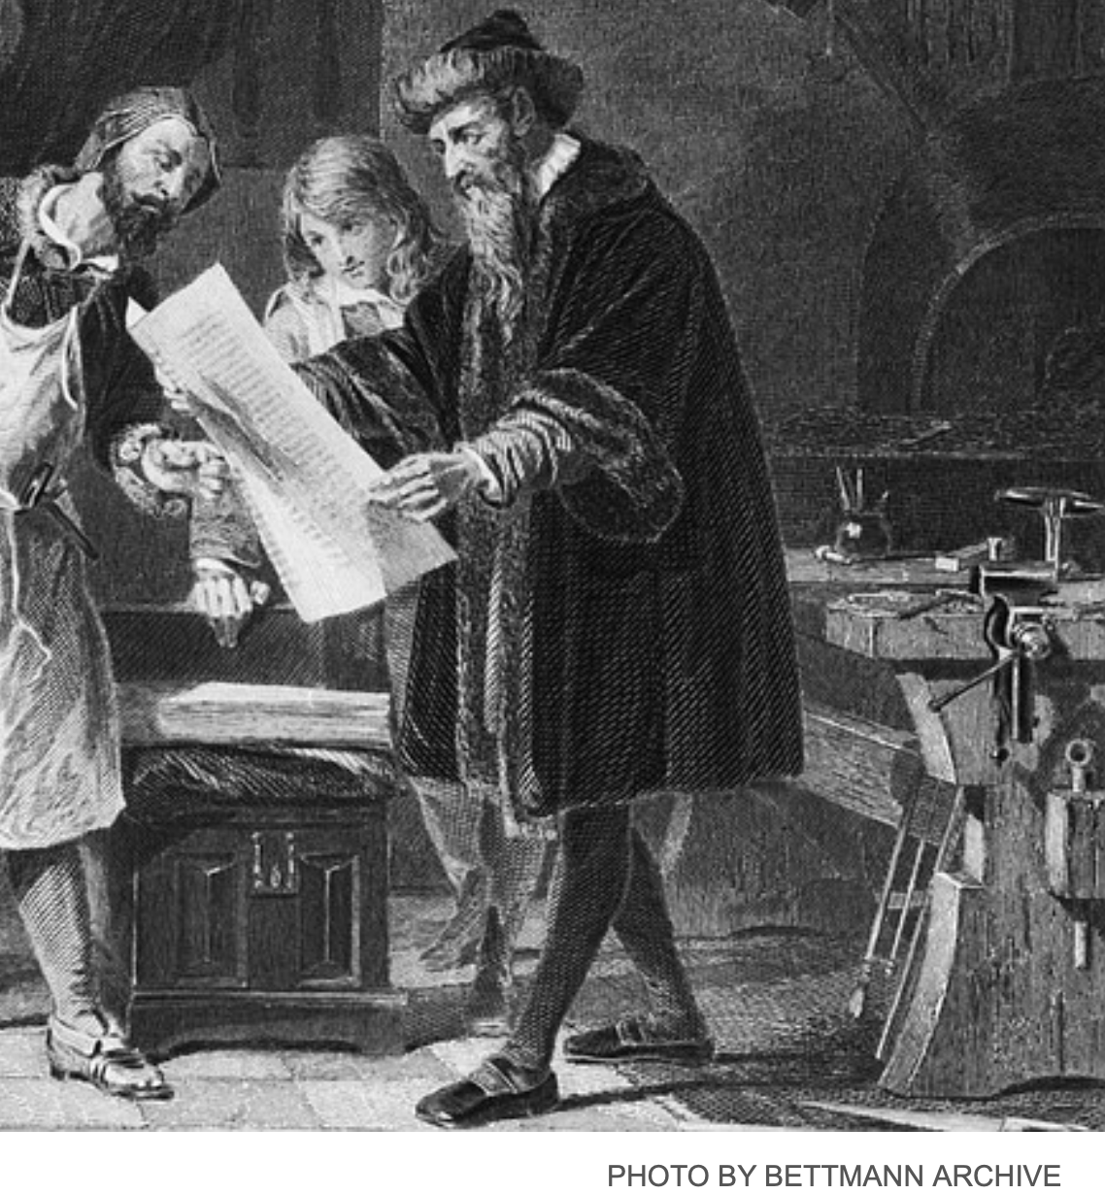
Gutenberg Arrives!
Scribes: 3000 words a day:
Max Roser: In 1483… three florins… Ripoli… produced 1,025 copies… the scribe would produce one copy for one florin… cost per book decreased 341 times <http://tinyurl.com/ybvbww3n>...
Another 20x since: $70,000 to $10
Yet the university remains:
“Lectures” then become…
Structured repetition in different channels (eyes, ears)
Commentaries, highlights, & dialogues—real or constructed—about the text
Notes:
That was the origin of the university: get people together to hear books read aloud. That was how universities got their start, back when books were really expensive. They were the only places you could read a few unpopoular books (in the library) and listen to the popular books books being read aloud (in the lectures). But then came Johann Gutenberg, and the printing press, and movable type, and books became really cheap. You could have your library, and read your books, almost anywhere. Yet universities did not disappear. And lectures did not disappear. They lost their principal purpose—of economizing on the number of copies of a book a univeristy needed to function—but they became: ways of getting people to go over again, in their minds, what they had read—structured repetition as a learning aid—of getting people to think actively about the ideas and connect them to things in their own mind, of getting people to engage in dialogues about the ideas, and in mobilizing human group solidarity for the educational process.

Slide 14

Yet the University Remains
Notes:
The university did not die after Gutenberg. It flourished. At this point, as is traditional at Berkeley, you are allowed to boo, if you wish. It is the custom of the country that you are allowed to boo at any picture of the Stanford campus, if you did not already know that.

Slide 15

MOOCs?
There was a big MOOC movement a decade ago
Massive Open Online Courses…
They were supposed to replace the in-person lecture course…
There were some who said or hoped they would replace the university…
They didn’t…
Why not? It turned out to be very important to:
Get people to do things in groups
Get people in the classroom in contact with each other outside the classroom
Arrest attention with live human voices and faces
Notes:
But we can no longer gather in lectures—or, rather, we do not want to run the risks involved in bringing all 100,000 or so people back to the Berkeley campus in the fall and have us act as we normally do, because we think that if we do so 60,000 of us will get sick and 500 of us—largely elderly professors and staff—die. So we are doing this instead. The problem is that making this work is very hard. We saw how hard a decade ago, with the big MOOC movement of a decade ago. Massive Open Online Courses were supposed to replace at least the in-person lecture course, and there were some who thought or hoped they would replace or at least totally transform the—expensive—university. They didn’t. Why not? It turned out to be very important to: (1) get people to do things in groups, (2) get people in the classroom in contact with each other outside the classroom, and (3) arrest and focus attention with live human voices and faces. And—as you know if you have thought about the difference between in-person plays and on-screen movies—there are lots of subtle and important ways in which our screen technologies just do not cut it.

Slide 16
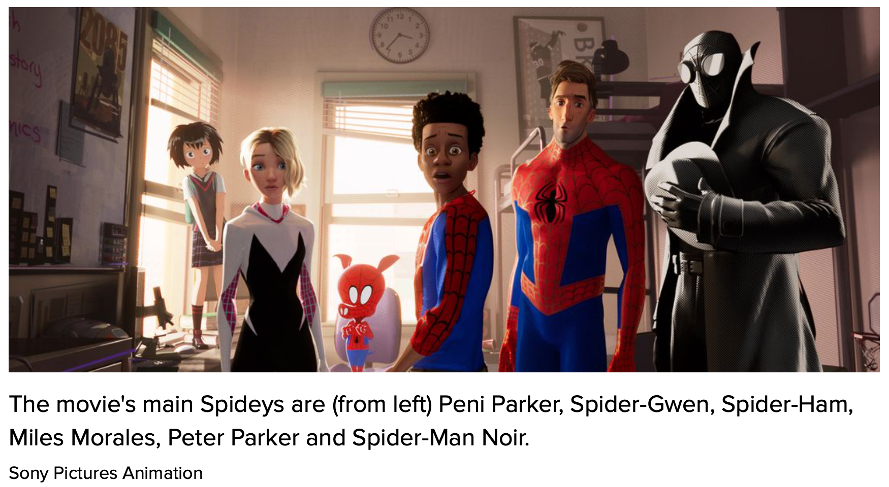
$500K/Minute
To make a video that fully grabs your attention…
Admittedly, this two-hour video was best-in-the-world for 2018
As shown by how my first cousin Phil and his team made Columbia, Sony, & Marvel rich… richer…
Notes:
Now, it can be done. The theme of which my first cousin Phil Lord down in Ell-Ay was one of the heads did it. But they spent $500,000 per minute creating _Spiderman: Into the Spiderverse_. Do that, and you can create something that is fully immersive and more effective than anything we see in person. Of course, you need more than money: you need genius too, and a lot of luck.

Slide 17
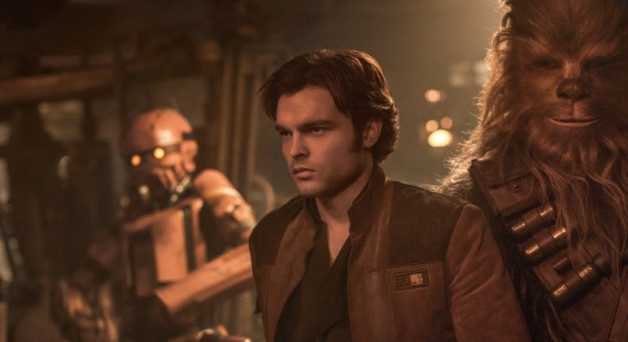
Solo Origin Story
Phil & team were bounced due to “creative differences”…
They were given the greenlight, but Disney executives did not then like what they had agreed to…
Lost $80 million on an insufficiently arresting video. Destroyed all future Star Wars origin spinoffs
Notes:
How much luck? Consider _Solo: A Star Wars Story_. The team composed of Phil and company were bounced out of the project in the middle due to “creative differences”. As I understand it, they had proposed to make a Star Wars movie that was a lot more like _Guardians of the Galaxy_ had been. They were given the greenlight. But in the middle of the project the Disney executives decided that the movie that they did not want to eat what they had ordered. So I will never see Phil, Chris, and the team’s view of the Han Solo origin story. Instead, we have a movie that lost Disney $80 million, and that brought a screaming halt to a number of projects—in fact, to all of what was supposed to be a series of future Star Wars origin spinoffs. Making convincing and arresting video is very hard.

Slide 18
We Thus Have an Uphill Climb
We don’t have $500K/minute to spend
And we here are not creative geniuses like my first cousin Phil and his team are.
We face an intellectual crisis
Hence this meta-module
Not learning, but learning how to try to learn
Plus: What is economics, and what is it good for?
Notes:
We thus have an uphill climb. We don’t have $500K/minute to spend. And we here are not creative geniuses like my first cousin Phil and his team are. American universities are frantically piling online so that we can keep teaching. And as we do so we face an intellectual crisis about how to do our job through a screen—which is a very difficult task. Unless and until we successfully figure out how to do our job through a screen, we are going to make a total hash of moving online. Hence this first, preliminary, module of this course: a meta-module; a “how are we going to try to learn this semester” module. And also in this module I also ask and suggest some possible answers to the questions: what is economics? And: what is economics good for?
Once again: welcome. I very much hope you learn stuff here, wherever “here” is, virtually. And I very much hope you have some fun here this semester.

Slide 19
Catch Our Breath…
Ask a couple of questions?
Make a couple of comments?
Any more readings to recommend?
<>

Slide 20
Addendum: Script
Welcome to this course. I am Brad DeLong. This is my basement in the Elmwood neighborhood of Berkeley—near Ashby and college, about a mile south of the campus and about a mile north of the Rockridge BART.
Actually, that is not what it looks like now: this is a picture I took last May. What does it look like now? Behind myself as I sit at my basement desk, I have hung a green blanket. Why? To give the microprocessor in my laptop a fighting chance of distinguishing me from the background so that it can then do visual tricks to, hopefully, keep you somewhat engaged and slighty amused, and thus help you in the process of educating yourself.
What kind of tricks? Tricks like this.
This is a background against which, famously, a four-person fellowship was assigned a task in a movie.
But most of the time you will see backgrounds that are less overwhelming, while still being—we hope—visually interesting.
And most of the time you will see illustrations that will be—we hope—visually interesting and informative. This, for example, shows, week by week, from March to July 2020, how many American workers received unemployment insurance last week and had also received it the week before.
The collapse of employment and the rise of unemployment when the coronavirus plague hit was stunning: back in 2009 we had thought that the collapse of employment and the rise of unemployment in 2008-9 was stunningly big and stunningly fast. We were like John Snow in Game of Thrones: we knew nothing.
My voice, my face, my eyes, my mouth. Why have I filled your ears with the first, and put the others in front of your eyes—albeit off here in a corner? Why have I not simply assigned you some books, then said: “the exam will be in early December”, and left you to do your thing? Why are we making you glue your eyes to this screen? I have done do because we are built to find human faces and

Slide 21
Addendum: Script 2
human voices uniquely arresting, interesting, and attention focusing.
Books are—a lot of the time—boring. In-person faces, gestures, and voices are a lot better.
How do we know this?
We know this because the university survived the coming of printing. Let us back up two thousand years. Back then, when universities got their start, books were really, really expensive. The most comprehensive record of prices—or, rather, of what it was thought prices ought to be—in the distant past comes from an edict issued in the year 301 by the man who stabilized the resounded Roman Empire and gave it more centuries of life: the Emperor Diocletian. In his price edict he limited how much a scribe could charge for producing a copy of a book to 25 denarii to write 100 lines.
What is the context? The context is that a 2.2-lb. loaf of bread costs 13 denarii, and to hire an unskilled worker for the day costs 36 denarii. A cheap book—the kind of thing you could get for,
say, $10 today—thus cost the same as 440 pounds of bread, or 70 days’ work at minimum wage. Compare to today, when a cheap book costs the same as 5 pounds of bread, or 40 minutes’ work at minimum wage.
With books so expensive, how then did you get educated—unless you were already very rich to start with? The answer was that you had to travel to where the books were. With a cheap book costing the same proportion of the daily wage then as 70 days x 10 hours/day x 15/hour = 10,500 dollars is a proportion of the daily wage today, and with expensive high-quality durable books costing much more, how many books you needed to read, how many copies of, say, Aristotle’s _Nicomachean Ethics_ do you thin there were in Western Scotland in 1460? You traveled to the University of Glasgow. And there you—and all the others who wanted to learn about Aristotle’s _Nicomachean Ethics_, listened to somebody read the book aloud: “legit” it in a “lecture”, while you took your notes on it. Because afterwards your memory and your notes would be the only contact you had with

Slide 22
Addendum: Script 3
Aristotle’s ideas: you certainly could not afford to spend the equivalent of $10,500 a book for anything other than your most favorite books.
That was the origin of the university: get people together to hear books read aloud. That was how universities got their start, back when books were really expensive. They were the only places you could read a few unpopular books (in the library) and listen to the popular books books being read aloud (in the lectures). But then came Johann Gutenberg, and the printing press, and movable type, and books became really cheap. You could have your library, and read your books, almost anywhere.
Yet universities did not disappear.
And lectures did not disappear.
They lost their principal purpose—of economizing on the number of copies of a book a univeristy needed to function—but they became: ways of getting people to go over again, in their minds, what they had read—structured repetition as a learning aid—of getting people to think actively
about the ideas and connect them to things in their own mind, of getting people to engage in dialogues about the ideas, and in mobilizing human group solidarity for the educational process.
But we can no longer gather in lectures—or, rather, we do not want to run the risks involved in bringing all 100,000 or so people back to the Berkeley campus in the fall and have us act as we normally do, because we think that if we do so 60,000 of us will get sick and 500 of us—largely elderly professors and staff—die.
So we are doing this instead.
The problem is that making this work is very hard.
We saw how hard a decade ago, with the big MOOC movement of a decade ago.
Massive Open Online Courses were supposed to replace at least the in-person lecture course, and there were some who thought or hoped they would replace or at least totally transform the—expensive—university. They didn’t. Why not? It turned out to be very important to: (1) get people to do things

Slide 23
Addendum: Script 4
in groups, (2) get people in the classroom in contact with each other outside the classroom, and (3) arrest and focus attention with live human voices and faces. And—as you know if you have thought about the difference between in-person plays and on-screen movies—there are lots of subtle and important ways in which our screen technologies just do not cut it.
Now, it can be done. The theme of which my first cousin Phil Lord down in Ell-Ay was one of the heads did it. But they spent $500,000 per minute creating _Spiderman: Into the Spiderverse_. Do that, and you can create something that is fully immersive and more effective than anything we see in person. Of course, you need more than money: you need genius too, and a lot of luck.
How much luck? Consider _Solo: A Star Wars Story_. The team composed of Phil and company were bounced out of the project in the middle due to “creative differences”. As I understand it—and I may well have got this wrong—they had proposed to make a Star Wars movie that was a lot more like
_Guardians of the Galaxy_ had been. They were given the greenlight. But in the middle of the project the Disney executives decided that the movie that they did not want to eat what they had ordered.
So I will never see Phil, Chris, and the team’s view of the Han Solo origin story.
Instead, we have a movie that lost Disney $80 million, and that brought a screaming halt to a number of projects—in fact, to all of what was supposed to be a series of future Star Wars origin spinoffs.
Making convincing and arresting video is very hard, even if you are world-class in your talent, your acquired skills, your expertise, and have oodles and oodles and oodles of money.
We thus have an uphill climb.
We don’t have $500K/minute to spend. And we here are not creative geniuses like my first cousin Phil and his team are. American universities are frantically piling online so that we can keep

Slide 24
Addendum: Script 5
teaching. And as we do so we face an intellectual crisis about how to do our job through a screen—which is a very difficult task.
Unless and until we successfully figure out how to do our job through a screen, we are going to make a total hash of moving online.
Hence this first, preliminary, module of this course: a meta-module; a “how are we going to try to learn this semester” module.
And also in this module I also ask and suggest some possible answers to the questions: what is economics? And: what is economics good for?
Once again: welcome. I very much hope you learn stuff here, wherever “here” is, virtually. And I very much hope you have some fun here this semester.

